Slide 1


Qubit Games: A project of OOPJ Concepts
Qubit Games is a collection of classic and thrilling Java-based games, each designed to demonstrate the power and versatility of Object-Oriented Programming (OOPJ) principles. From the iconic Flappy Bird to the strategic Tic Tac Toe and the addictive Snake Game, these titles showcase the mastery of Java OOPJ concepts.
Done By:
AM.SC.U4CSE23102 Abhay Mathummal
AM.SC.U4CSE23105 Akhil Kannan
AM.SC.U4CSE23125 Josewin Anto

Slide 2
Various Operations and Tasks Implemented
1
Encapsulation
2
Inheritance
Ensuring data privacy and integrity through well-defined classes and methods.
Leveraging shared functionality and code reuse across game entities.
3
Polymorphism
4
Exception Handling
Allowing game objects to adapt their behavior based on the current context.
Implementing robust error management to provide seamless user experiences.

Slide 3
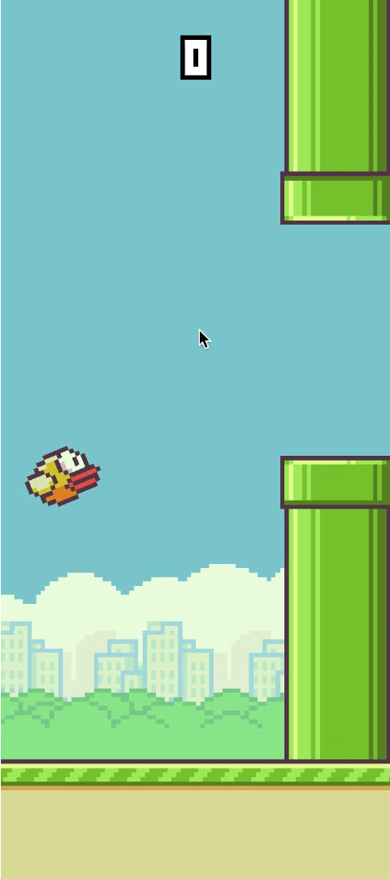
Flappy Bird: Navigating through Obstacles
1
Gravity Mechanics
Accurately simulating the bird's flight and descent to create a challenging gameplay experience.
2
Collision Detection
Implementing precise collision detection to ensure the player avoids obstacles and pipes.
3
Score Tracking
Keeping track of the player's score and displaying it in real-time to measure their progress.

Slide 4
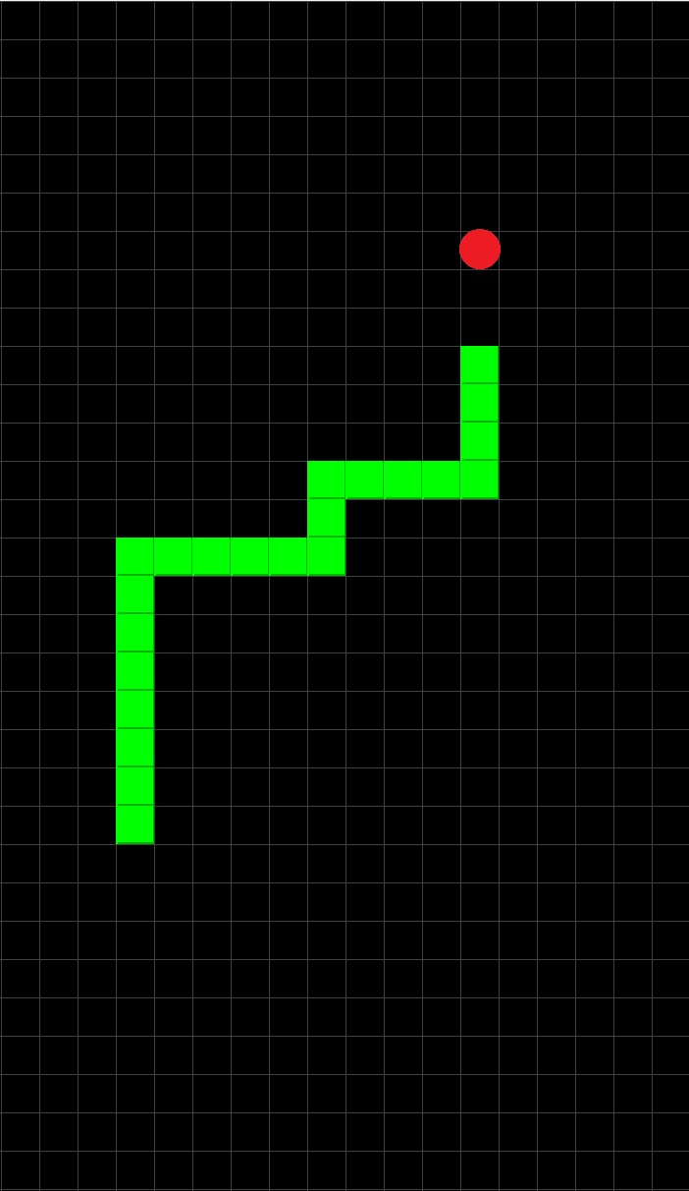
Snake Game
1
Player Moves
Allowing players to make moves and validating them to ensure the game rules are followed.
2
Collision Detection
Maintaining a logical representation of the game board to track the state of the game.
3
Food Generation
Randomly spawning food items for the snake to consume, increasing its length.
4
Score Tracking
Keeping track of the player's score based on the snake's length.

Slide 5
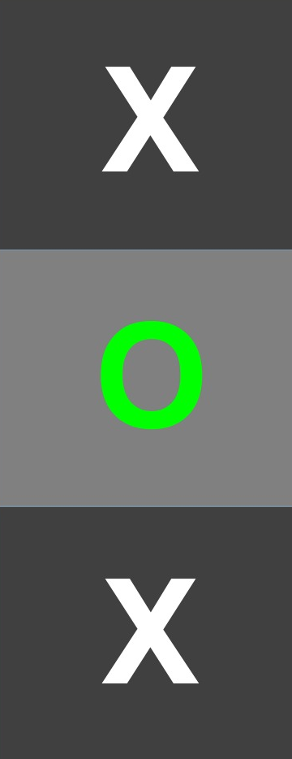
Tic-Tac-Toe: Logical Block(s) & Strategy
1
Player Moves
Allowing players to make moves and validating them to ensure the game rules are followed.
2
Board Representation
Maintaining a logical representation of the game board to track the state of the game.
3
Win Conditions
Implementing algorithms to detect and declare the winner based on the game's rules.

Slide 6
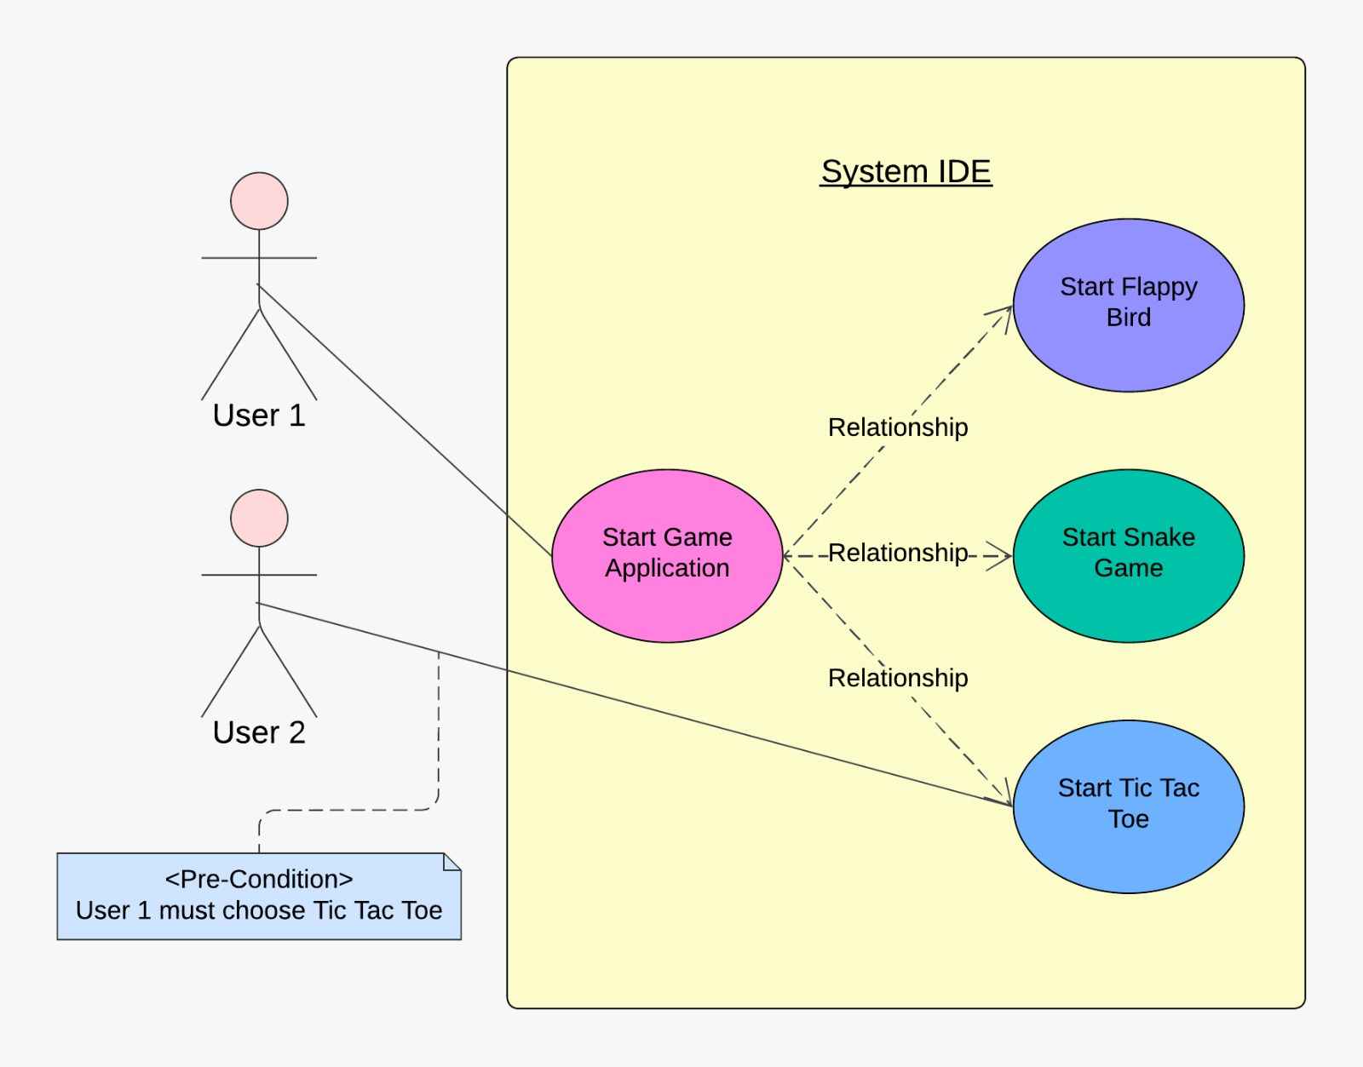
1
Use Case Diagram
.

Slide 7
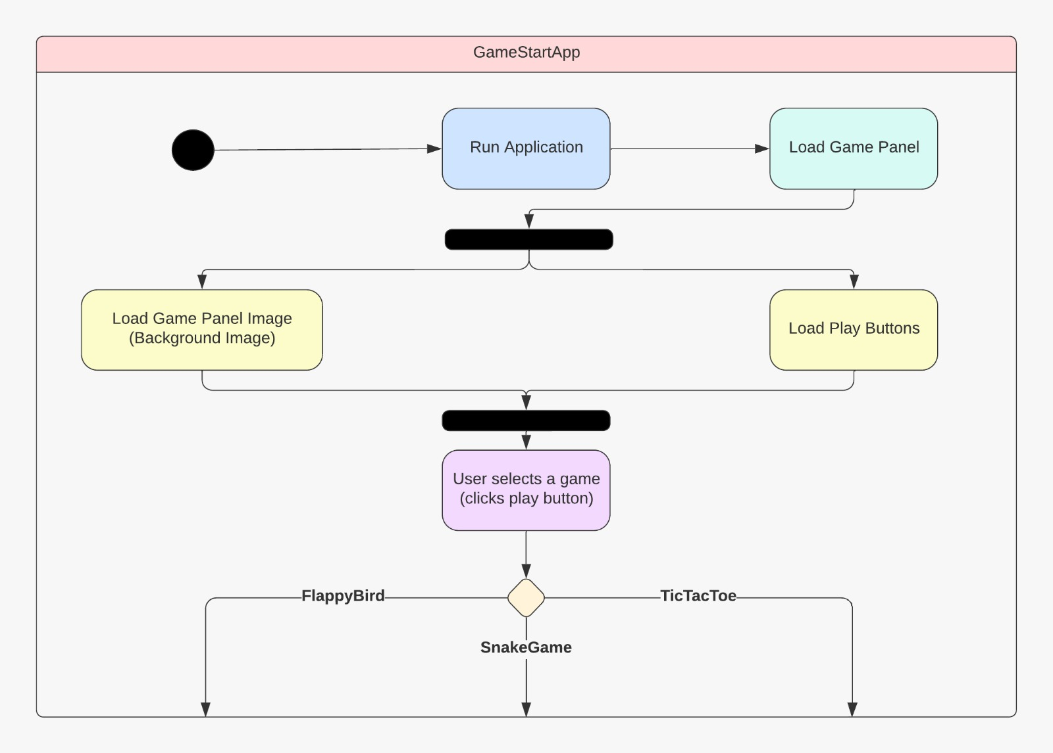
2
Activity Diagram
.

Slide 8
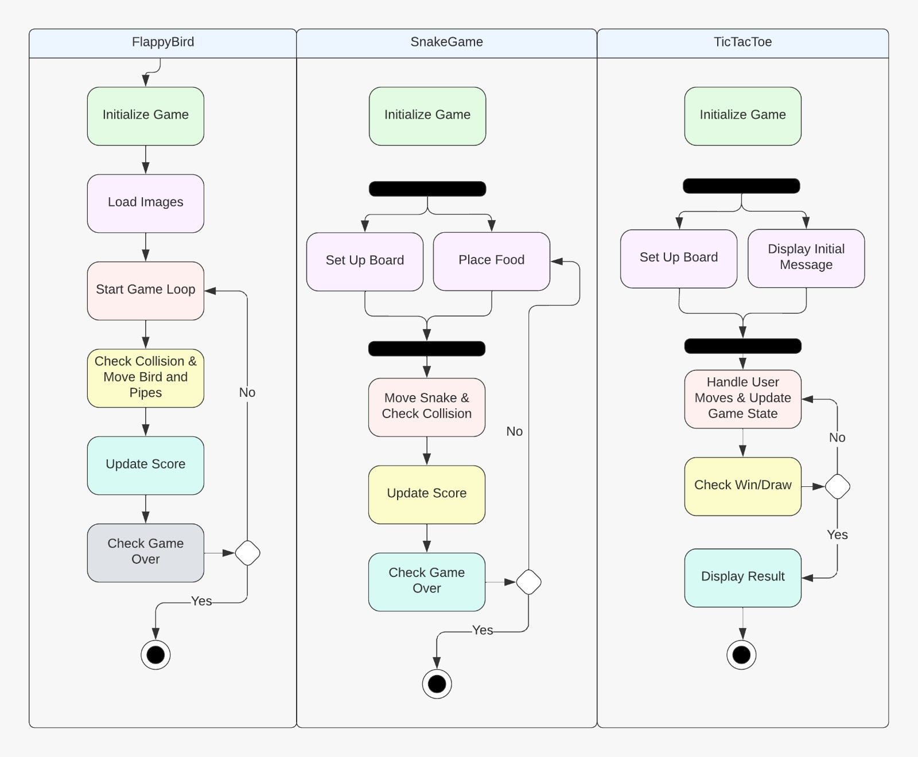
.

Slide 9
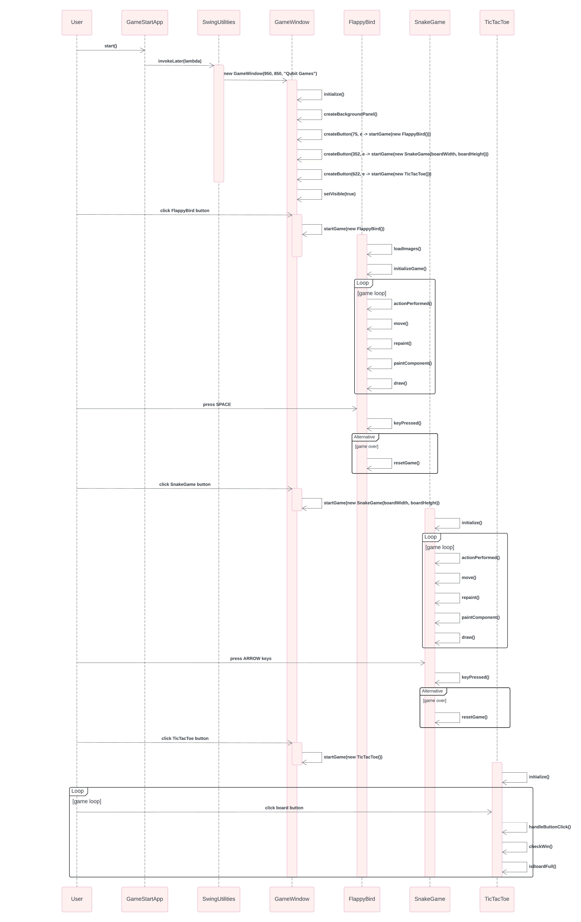
Sequence Diagram
3
.

Slide 10
.

Slide 11
.

Slide 12
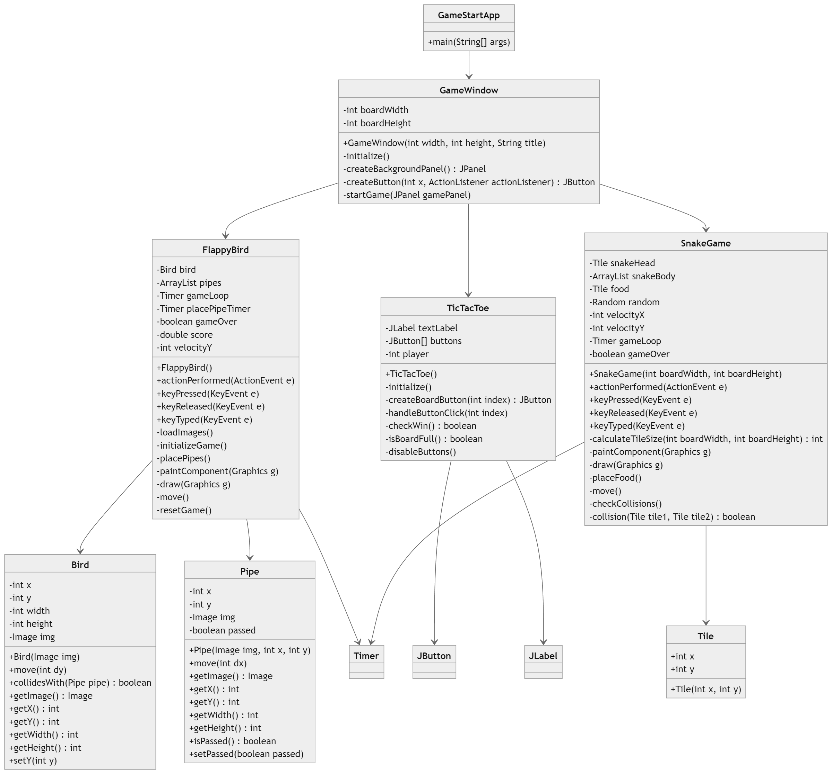
Class Diagram
4
.

Slide 13
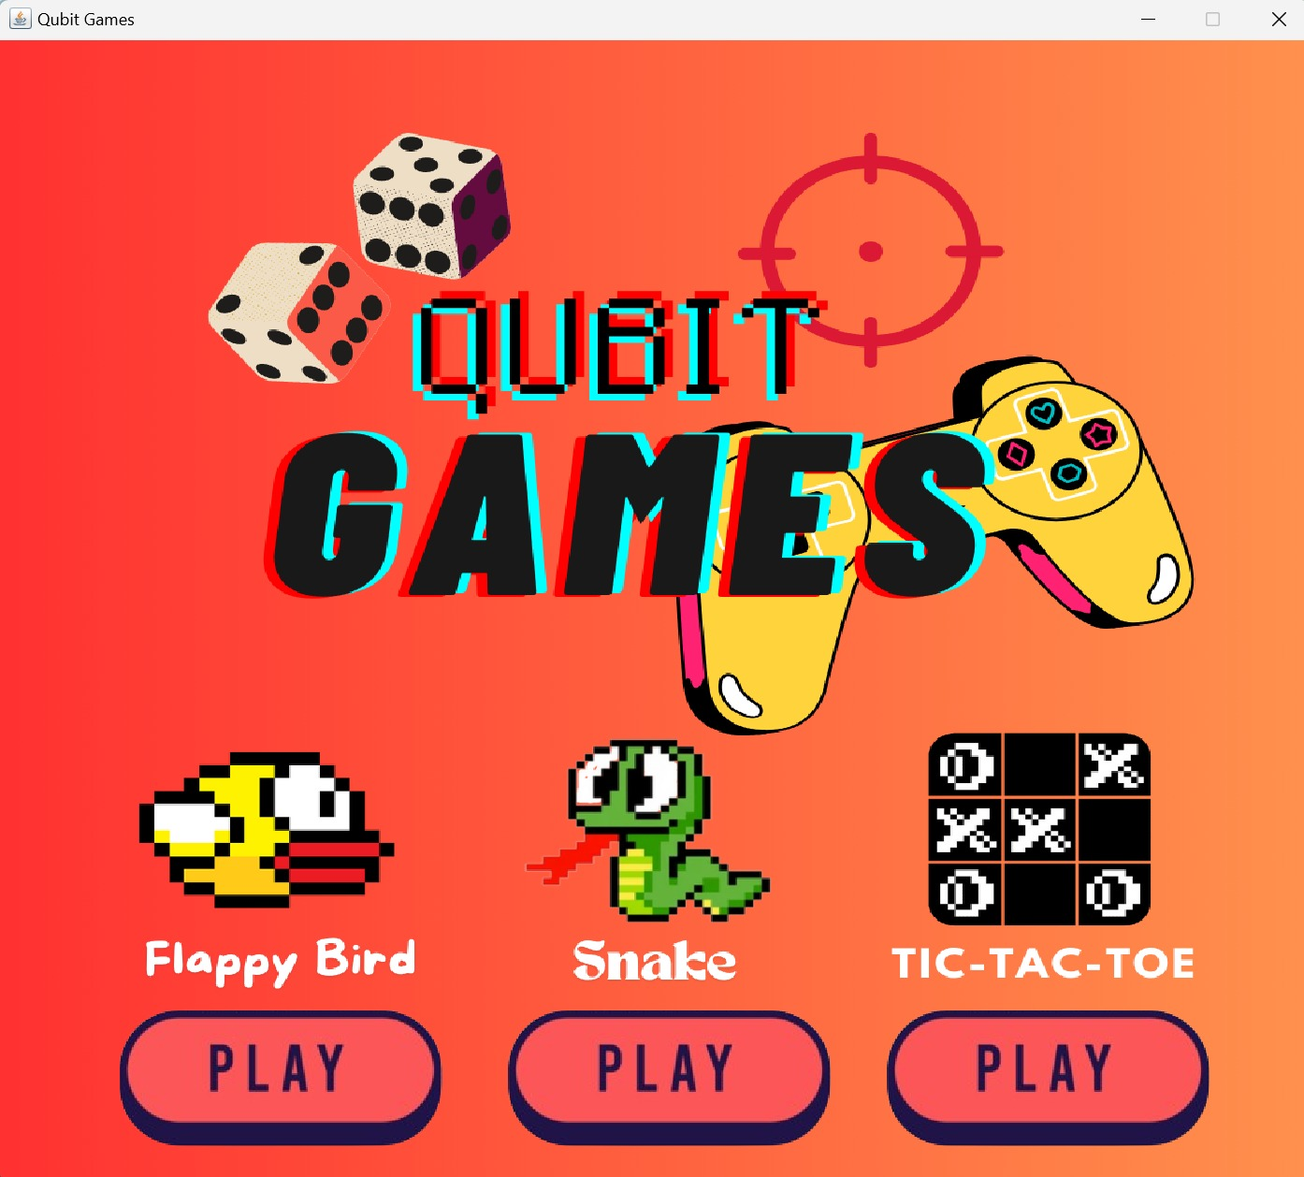
Game Interface
.

Slide 14
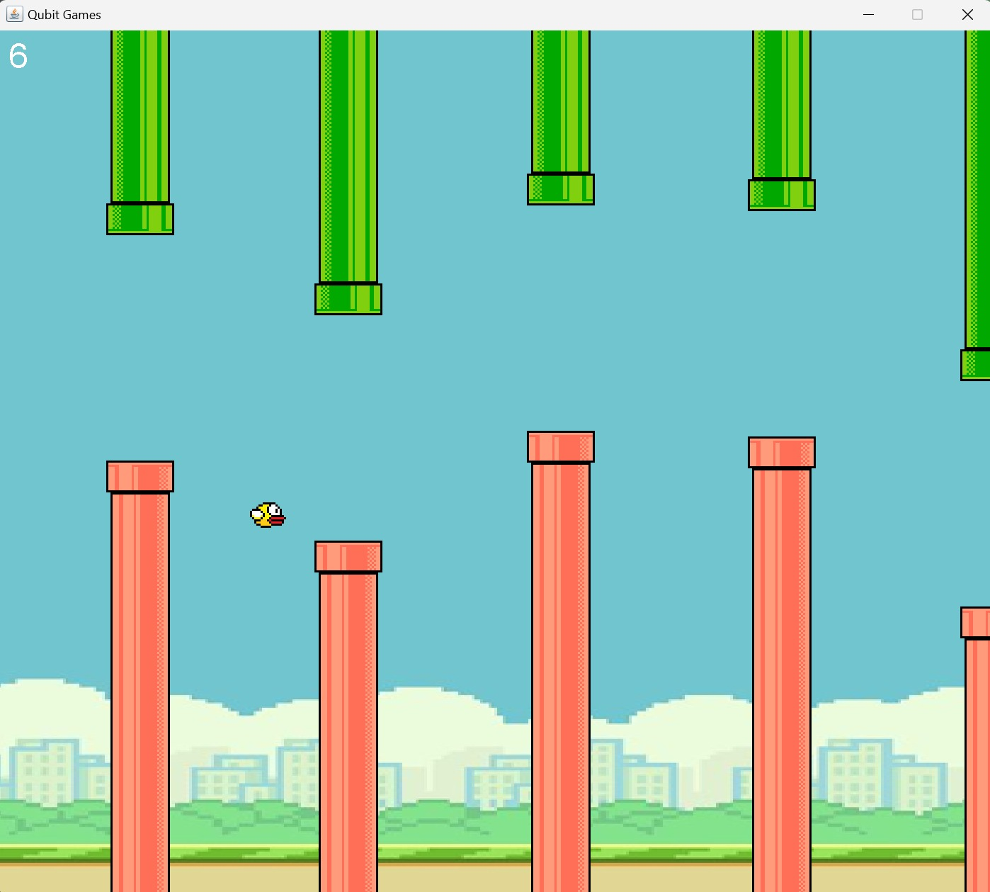
Flappy Bird
.

Slide 15
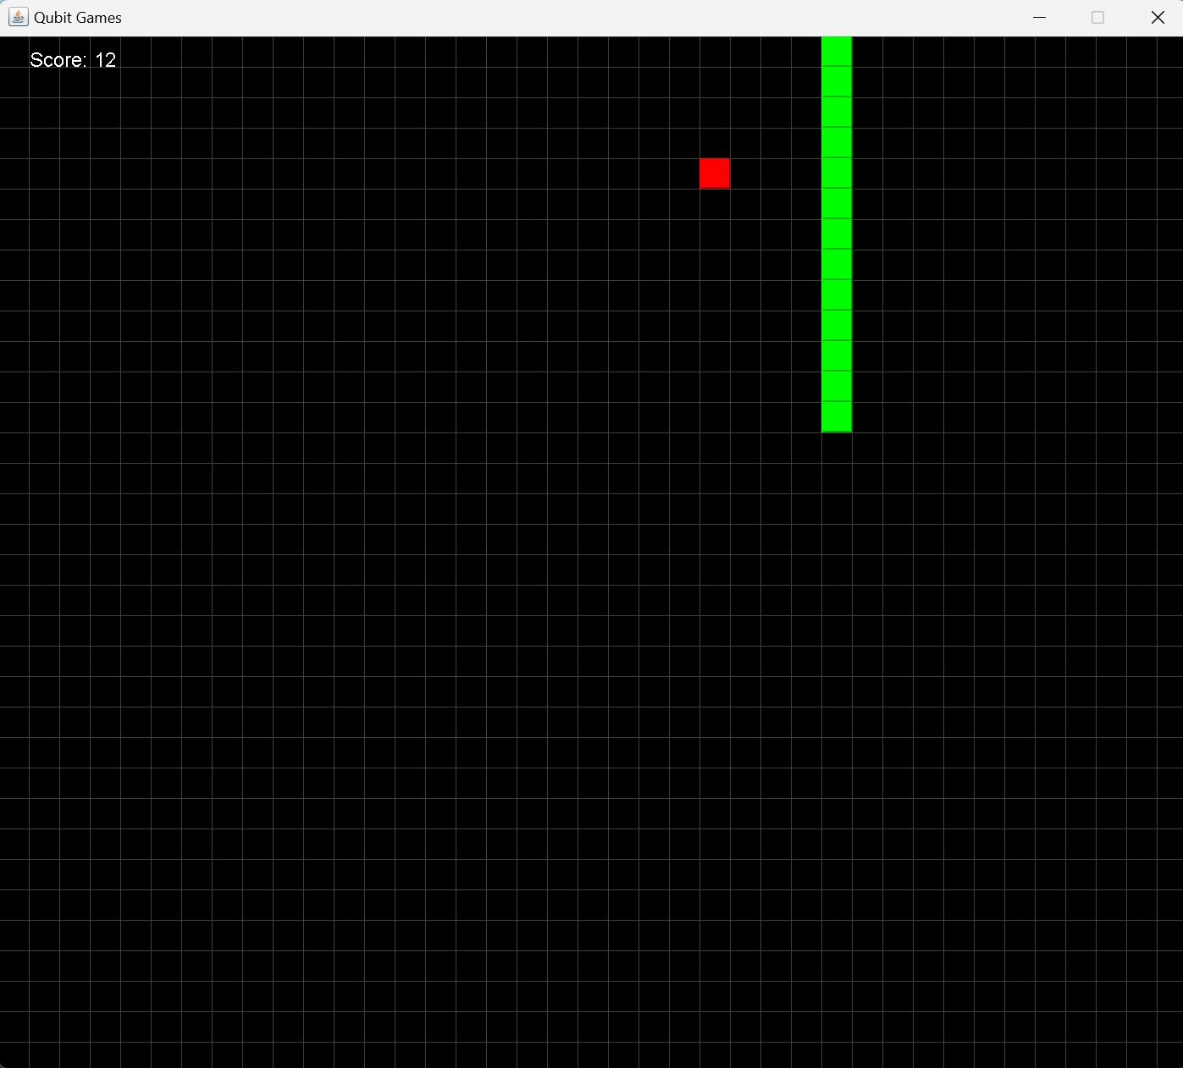
Snake Game
.

Slide 16
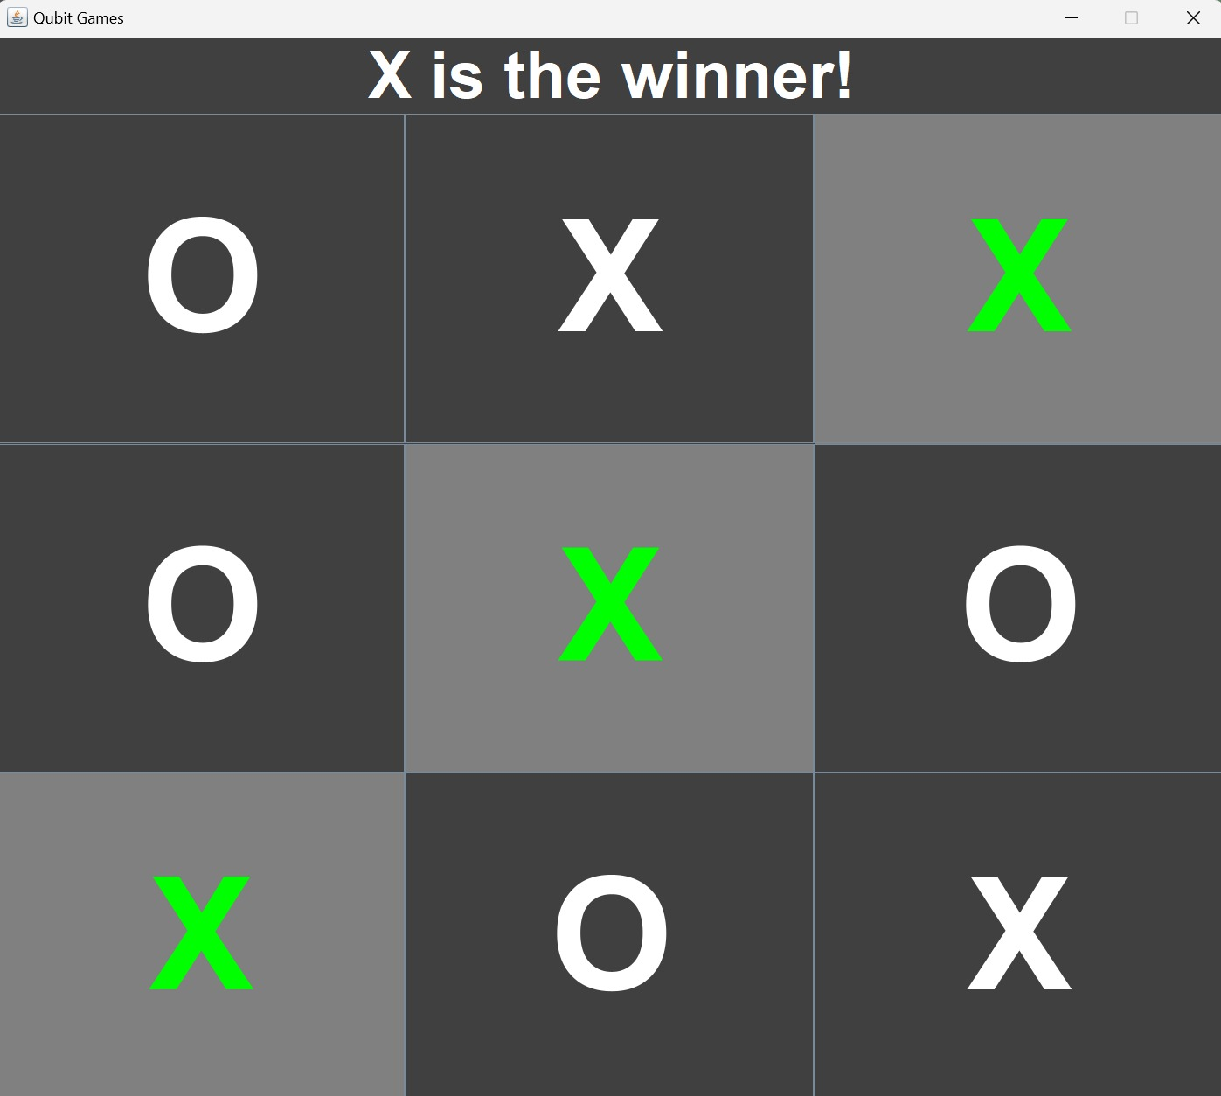
Tic-Tac-Toe
.

Slide 17




Object-Oriented Programming Principles
Abstraction
Inheritance
Polymorphism
Encapsulation
Focusing on essential features and hiding complexities within game objects.
Leveraging shared functionality and code reuse across game entities.
Allowing game objects to adapt their behavior based on the current context.
Ensuring data privacy and integrity through well-defined classes and methods.

Slide 18




Game Design and Development Challenges
৹ Gameplay Mechanics
৹ User Interface
৹ Performance Optimization
Designing intuitive and engaging gameplay mechanics for each game.
Developing a visually appealing and responsive user interface.
Ensuring efficient memory management and frame rate for smooth gameplay.

Slide 19

Conclusion:
Qubit Games shows the versatility of Java OOP concepts, by skillfully integrating the 4 principles, we have created a collection of classic games that showcase the depth and flexibility of object-oriented programming. Qubit Games is a display of Java OOP in action.

